Slide 1


Slide 2
Today’s Session
1
Introduction to Working Smart program and how it was developed
2
Understand Working Smart application and partnership structure
3
4
Discuss Working Smart as a component of community college and HRD workforce response
Identify rollout parameters and regional training opportunities

Slide 3

What it is
A soft skills curriculum designed to provide the work and life skills that enhance employee productivity
What it is not
A job search or job readiness curriculum (e.g., resumes, finding a job, etc.)

Slide 4
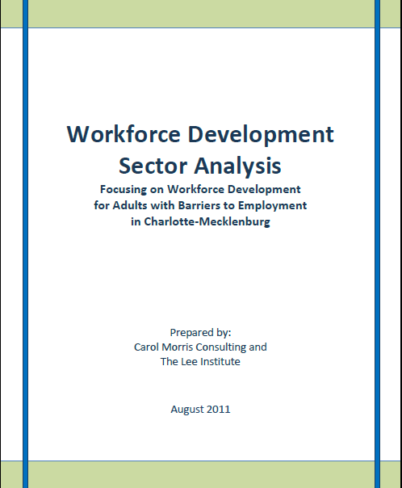
Better Together:
The History of Working Smart
Notes:
In 2010 the Charlotte Mecklenburg Workforce Development Board, Goodwill of the Southern Piedmont, and Jacob’s Ladder Job Center, sponsored an analysis of the workforce development sector.
Funded by Foundation for the Carolinas.
Consultants: The Lee Institute and Carol Morris Consulting.
2011 report released.

Slide 5
Better Together: The History of Working Smart
5 Major Shifts
Integrated sector
Dual customer focus
Career pathways
Holistic support
Continuum of services
Notes:
FUNDAMENTAL SECTOR-WIDE ISSUES IDENTIFIED BY CONSULTANT TEAM
1. The workforce sector generally operates as a patchwork of organizations working independently:
2.Weak linkages exist between the sector and the employer/demand-side of workforce development:
3. Employment expectations for low-skilled workers are often too low, with entry-level jobs seen as the
“end game”:
4.Individualized needs of job seekers are often not identified, and resources to address them are limited:
5. The continuum of services for job seekers is not fully developed in Charlotte-Mecklenburg.

Slide 6
Workforce Development Partners
Workforce Development Partners
  Gathered to address report recommendations
First two priorities:
    Common soft skills curriculum
    Common job development process
Two sub-committees formed
Grant received from Foundation for the Carolinas for curriculum development
2012
Notes:
Workforce Development Partners:
Center for Community Transitions, Charlotte Area Fund, Charlotte Works, Division of College and Career Readiness at Central Piedmont Community College, Career and Technical Education Program of Charlotte-Mecklenburg Schools, Goodwill Industries of the Southern Piedmont, Mecklenburg County Department of Social Services, Economic Services Division, North Carolina Division of Vocational Rehabilitation Services, Urban League of the Southern Piedmont

Slide 7
Soft Skills Sub-Committee
2013-2014
Reviewed prior employer survey
Developed and administered follow-up survey focusing on soft skills
Conducted focus group with area employers
Prioritized soft skill needs
Began development of curriculum with assistance from Dr. Steve Parese, national workforce development consultant
Notes:
Input from two employer surveys, employer focus group, and active job developers.

Slide 8








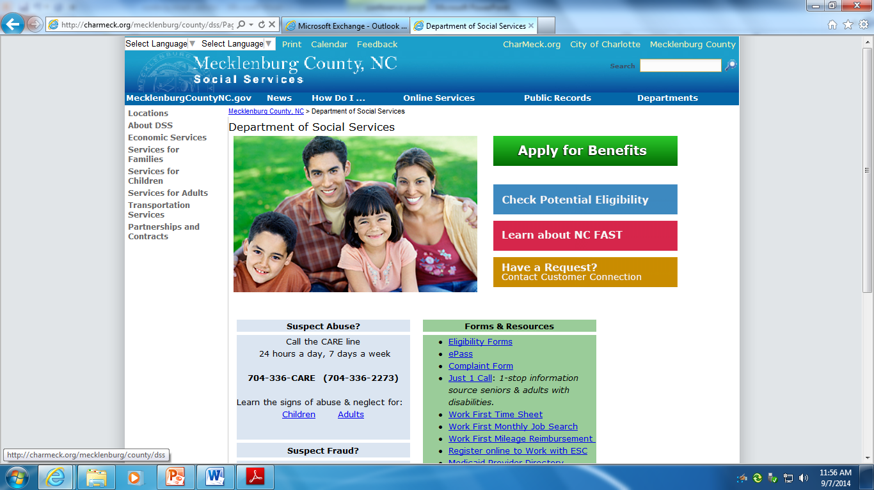
2014
Endorsed and certified by Charlotte Works
Piloted by five Charlotte-based organizations & Union County collaborative
Currently serving four collaboratives across the state

Slide 9
Let’s take a look at what Working Smart includes!

Slide 10

Five interactive modules
24 – 30 hour curriculum
Designed for adults with multiple barriers to employment
6th grade reading level
Notes:
Inside handout see a “Typical Soft Skills Lesson Outline”

Slide 11
Personal Branding
Self Change
Cognitive Cycle
Notes:
Personal Branding:
√ Learn how companies brand themselves
√ Describe our own personal brands
√ Identify changes needed to rebrand ourselves
Self Change
√ Identify behavior changes that would improve our lives
√ Learn about five stages of lasting change
√ Find strategies to move through the process of self-change
Cognitive Cycle
√ Learn how the “Cognitive Cycle” works
√ Understand how beliefs and behaviors are connected
√ Separate helpful beliefs from harmful beliefs

Slide 12
Dealing with Stress
Warning Signs
Personal Reactions
Staying Calm & Clear
Notes:
Dealing with Stress
√ Learn about three “survival instincts” in stress
√ Identify three kinds of stress
√ Learn coping strategies for each type
Warning Signs
√ Identify three kinds of warning signs in tough situations
√ Learn how to use warning signs to help us slow down
√ Apply this knowledge to our own situations
Personal Reactions
√ Identify four categories of personal overreactions
√ Categorize our own dominant style of reacting
√ Discuss how to respond assertively in tough work situations
Staying Calm and Clear
√ Learn a 3-step method for counteracting strong feelings
√ Understand the power of choosing our thoughts
√ Practice these skills in life-like situations

Slide 13
Employer
Expectations
Code Switching
Notes:
Employer Expectations
√ Explore 4 levels of reasons for working
√ Describe ways to learn an employer’s written rules
√ Understand 8 common but UNWRITTEN EXPECTATIONS
See inside of “Work Ethics” for the Employer Values and Expectations
Code Switching
√ Discuss beliefs that drive our personal behavior
√ Compare and contrast home versus work rules
√ Learn how to “code-switch” from home to work

Slide 14
Active Listening
4 C’s of Communication
Expressing Concerns
Handling Feedback
Notes:
Active Listening
√ Assess our own communication skills
√ Learn three ways to be better listeners
4 “C’s”
√ Judge the appropriateness of numerous modes of communication in various work situations
√ Understand the four C’s of communication (clear, concise, correct, and courteous)
Expressing Concerns
√ Learn a step-by-step method for calmly and professionally expressing a concern or complaint to supervisors/co-workers
√ Practice the step of “explaining your side” in a dispute
√ Apply this skill to realistic work situations
Handling Feedback
√ Learn a step-by-step method for calmly and professionally handling feedback from supervisors or criticism from customers
√ Practice the step of listening to others in a dispute
√ Apply this skill to realistic work situations

Slide 15
Problems and Goals
Facts versus Opinions
Options and Outcomes
Notes:
Problems and Goals
√ Learn a five-step approach to problem solving
√ Create logical problem statements for emotional situations
√ Create reasonable goal statements for these problems
Facts vs. Opinions
√ Define and separate facts from opinions
√ Describe eight ways of gathering relevant facts
√ Learn about the dangers of false assumptions
Options and Outcomes
√ Learn to brainstorm alternatives in problems
√ Predict consequences to ourselves and others
√ Use a goal-driven process to select the best option
There is also an additional lesson on “Time Management”

Slide 16
Working smart application
Workforce Development Collaboration is the cornerstone to a successful Working Smart implementation

Slide 17
Working smart application
CMWDP feels strongly that adults with multiple barriers to employment benefit more fully when agencies and service-providers work together with a common vision. That common vision was the catalyst for the development of Working Smart. Therefore, to stay true to the fidelity of the collaborative approach, the application requires the following:
Collaborative Group:
Applicant agencies must represent a collaborative group of at least two workforce development agencies that include direct service-providers such as community-based organizations, community colleges, public libraries, etc., AND at least one agency that serves as a direct pipeline to employers such as workforce development boards or chambers of commerce.
Designated Certifying Agency:
One agency must be designated as the certifying body that will endorse the Working Smart credential for that county/region and will ensure that the integrity of the program is maintained. This agency should have strong credibility with employers.

Slide 18
Working smart application

Slide 19
Working smart –
Community college scaled approach
As a part of the process to scale the Working Smart program across the community colleges and retain the integrity of the program the local collaboratives will require the following:
Collaboratives must consist of at least two entities (schools, organizations, or agencies) providing workforce development activities to area job-seekers
List the contact information of the agencies/organizations that comprise your workforce development collaborative below. Be sure to include the signature of each agency head.
Name of Organization/Agency:
Name of Agency Head:
Address:
Phone Number:
Brief Description of Primary Services Provided in the Community:
Signature of Agency Head:

Slide 20
Application – certifying agency
Identification of a 'certifying agency' within the collaborative
  The certifying agency should be the community college, workforce development board, or chamber of commerce
  The certifying agency is responsible for endorsing Working Smart certifications, promoting the program to businesses, and maintaining the program's integrity
  The certifying agency should identify a coordinator for the entire collaborative
Name of Certifying Agency:
Name of Agency Head:
Address:
Phone Number: | Email:

Slide 21
Application – collaborative coordinator
Identification of collaborative coordinator who is responsible for
  Maintaining a database of collaborative Working Smart trainers
  and graduates
  Maintaining a class schedule for collaborative partners
  Maintaining collaborative documentation to include agency
  agreements, applications to request access to training and
  instructor agreements
  Providing documentation and reports to Charlotte Works as
  requested
Name of Collaborative Coordinator:
Name of Agency:
Address:
Phone Number: | Email:

Slide 22
Working smart and hrd
Community College Human Resources Development programs strengthened through the use of a validated, transportable core curriculum (Working Smart) responding to employer requests for employability skill development.

Slide 23
Human resources development
NC General Statute 115D-1
The North Carolina Community Colleges System Office is designated as the primary lead agency for delivering workforce development training, adult literacy training, and adult education programs in the State.
1G SBCCC 200.97 HUMAN RESOURCES DEVELOPMENT PROGRAM CONTINUATION
Each college shall operate a Human Resources Development (HRD) program to provide assessment services, employability training, and career development counseling to unemployed and underemployed individuals. FTE shall be generated from HRD programs. Each college shall provide HRD instruction and support necessary for unemployed and dislocated workers to be served within the college service areas.

Slide 24
Program accessibility & Legislative support
G.S. 115D-5
(b) In order to make instruction as accessible as possible to all citizens, the teaching of curricular courses and of noncurricular extension courses at convenient locations away from institution campuses as well as on campuses is authorized and shall be encouraged. A pro rata portion of the established regular tuition rate charged a full-time student shall be charged a part-time student taking any curriculum course. In lieu of any tuition charge, the State Board of Community Colleges shall establish a uniform registration fee, or a schedule of uniform registration fees, to be charged students enrolling in extension courses for which instruction is financed primarily from State funds. The State Board of Community Colleges may provide by general and uniform regulations for waiver of tuition and registration fees for the following:…
(13) Human resources development courses for any individual who (i) is unemployed; (ii) has received notification of a pending layoff; (iii) is working and is eligible for the Federal Earned Income Tax Credit (FEITC); or (iv) is working and earning wages at or below two hundred percent (200%) of the federal poverty guidelines.

Slide 25

HRD Purpose –
Supporting Workforce Needs
These courses are designed to be short-term training opportunities which address specific employability needs. Students gain valuable lessons respective to skills needed to successfully navigate job entry, retention and performance, so as to achieve the individual’s potential and contribute to the strategic direction of the enterprise. Because HRD programs are operated within the community colleges they can be built to support the workforce needs specific to the local labor market and industry sectors.

Slide 26
Working smart & hrd
Need: Employability skills training – consistent, persistent employer request
Employability skills training which addresses barriers to employment
Core validated training program which is recognized and transportable
Consistent training program whose learning outcomes can be easily communicated to employers
Learning outcomes aligned with workplace skills employers identify as critical:
  Self-Awareness
  Self-Management
  Work Ethics
  Communication
  Problem Solving

Slide 27
HRD & working smart = workforce development
Workforce Development Partners
Workforce Development Boards
Community Colleges
Community Based Organizations
Leverage Delivery tools – Human Resource Development Programs
Reside in all 58 community colleges serving all 100 NC counties
Accessibility based on waiver provision
Core Training Program – Working Smart
Core training program supporting employer needs

Slide 28
NEW HRD Course code - tracking
Course ID | Course Title | Course Description | Base Hours | Max Hours
HRD-4100 | Working Smart | Working Smart is a soft-skills program developed by the Charlotte Mecklenburg Workforce Developmental Partners (CMWDP). It is designed to provide job-seekers the work and life skills that enhance employee productivity. Employers are looking for candidates who have the "soft-skills" that lead to success in the following ways: communication, problem solving skills, time management, accountability, and more. Requires Working Smart certified instructors and utilization of the Working Smart curriculum | 25 | 30

Slide 29
Additional CC partners for delivery
Basic Skills Programs / College and Career Readiness
The Workforce Innovation and Opportunity Grant – Title II has a strong alignment with promoting the integration of adult education with occupational education and workforce preparation activities.
LEVERAGE CC RELATIONSHIPS
BSP/CCR may partner with HRD to leverage resources to provide access to Working Smart courses
BSP/CCR may utilize BSP/CCR instructors to deliver Working Smart curriculum if the local HRD program does not have the capacity to respond to both workforce and BSP/CCR demands or institutional structure makes the partnership challenging
One Collaborative Agreement
Colleges should enter into one collaborative agreement for the Working Smart curriculum for their service area.
**Multiples may be necessary if a college service area spans multiple workforce boards – not due to multiple program areas within the college providing delivery of the curriculum

Slide 30
Working smart – CC Rollout
June 20, 2016 Webinar
Next Steps:
Identify local Workforce Development partners
Define collaboration team
Identify team roles
Submit Working Smart application
Coordinate faculty to attend Working Smart Regional Training session

Slide 31
Working smart – CC Rollout
Regional Working Smart 4-day training opportunities
September 2016
November/December 2016
February 2017
April 2017
Cost: $250*
*Includes training, student & instructor materials and lunch

Slide 32

Questions/More Information
Contacts:
Working Smart Program
James Merrick, Program Coordinator
jmerrick@charlotteworks.com
704.206.1379
www.WorkingSmartNC.com
Community College System
Margaret Roberton
robertonm@nccommunitycolleges.edu
919-807-7159
Teretha Bell
bellt@nccommunitycolleges.edu
919-807-7215

