Slide 1
Update on Implementation of North Carolina Session Law 2023-132, Accreditation

Slide 2
General Statutes 115D-6.2
Accreditation.
(a) Definitions. – The following definitions apply in this section:
(1) Accreditation cycle. – The period of time during which a community college is accredited.
(2) Accrediting agency. – An agency or association that accredits institutions of higher education.
(3) Regional accrediting agency. – One of the following accrediting agencies:
Higher Learning Commission.
Middle States Commission on Higher Education.
New England Commission on Higher Education.
Northwest Commission on Colleges and Universities.
Southern Association of Colleges and Schools Commission on Colleges.
Western Association of Schools and Colleges Accrediting Commission for Community and Junior Colleges.

Slide 3
General Statutes 115D-6.2
Accreditation.
(b) Prohibit Consecutive Accreditation by an Accrediting Agency. – A community college shall not receive accreditation by an accrediting agency for consecutive accreditation cycles except as provided in subsection (c) of this section.
(c) Accreditation Transfer Procedure. – A community college that pursues accreditation with a different accrediting agency in accordance with this section shall pursue accreditation with a regional accrediting agency. If the community college is not granted candidacy status by any regional accrediting agency that is different from its current accrediting agency at least three years prior to the expiration of its current accreditation, the community college may remain with its current accrediting agency for an additional accreditation cycle.
(d) Certain Programs Exempt. – The requirements of this section do not apply to professional, departmental, or certificate programs at community colleges that have specific accreditation requirements or best practices, as identified by the State Board of Community Colleges.

Slide 4
Requirements for Initial Accreditation
Each accreditor has its own policies and procedures for institutions seeking initial accreditation. While every process is unique for each accreditor and to each institution, generally institutions must:
→ Demonstrate that all eligibility requirements are met.
→ Achieve (or maintain) candidacy.
→ Achieve initial accreditation.
The process by which institutions receive initial accreditation may require:
Site visits to on and off-campus locations
Pre-application / evidence of eligibility
Written narrative,
Documentation, or report
Virtual correspond-dence

Slide 5
NC Activities
October 2023
North Carolina Session Law 2023-132 went into effect, prohibiting UNC institutions and NC community colleges from receiving accreditation by an accrediting agency for consecutive accreditation cycles.
December 2023
UNC and NC Community Colleges system offices issued joint Request for Information (RFI) seeking accrediting agencies’ interest in adding NC’s institutions to their portfolios.
January 2024
System offices met with the U.S. Department of Education (USED) staff to discuss timelines and processes.
February 2024
Three accreditors responded to the RFI:
Accrediting Commission for Community and Junior Colleges (ACCJC)
Higher Learning Commission (HLC)
Middle States Commission on Higher Education (MSCHE)

Slide 6
RFI Responses
 | ACCJC | HLC | MSCHE
Accepting new candidates and willing to accept NC institutions? | Open to long-term relationships; do not believe a single-cycle approach provides value to membership and/or NC institutions | Welcomes eligible institutions, including NC institutions, to apply. Indicated preference for long-term relationships | Welcomes eligible institutions, including NC institutions, to apply. Indicated preference for long-term relationships
Interest in accrediting single institutions vs. entire systems? | Open to primarily associate degree-granting institutions that can commit to more than a single accreditation cycle | All degree-granting NC institutions that meet eligibility requirements are invited to apply | All degree-granting NC institutions that meet eligibility requirements are invited to apply
Process for institutions to be granted accreditation as a system? | Accredits individual institutions | Accredits individual institutions and also many systems | Accredits individual institutions
Timeline for initial accreditation? | Months to years | 18 months (accelerated) | 23-30 months
Mid-term review? | After 4 years | After 4 years | Annual review
Estimated start-up cost? | $8,000 | $23,650 (accelerated) | $43,000

Slide 7
RFI Responses
 | ACCJC | HLC | MSCHE
Requirements for application? Note: actual timelines are institution-specific | Demonstrate all eligibility requirements are met. (<1 month) Achieve candidacy and/or initial accreditation. (~6 months) Institutions able to meet all Accreditation Standards and Commission policies may achieve accredited status. (Completion of the initial Candidacy Visit) Institutions that meet all Eligibility Requirements but do not substantially meet all Accreditation Standards may be granted Candidacy and required to complete a follow-up report. (Must be completed within two years) | Accelerated Process (~18 months) Possible option for institutions currently accredited by a historically regional accreditor. Achieve initial accreditation through application, asynchronous peer review, on-site visit. Traditional Process Demonstrate all eligibility requirements are met via application (~2 months), interview (~4 months), letter of intent (within 2 years), eligibility filing (within 12 months), initial determination (~2 months), submission of follow up documents (within 12 months) Achieve candidacy (typically takes 12 months) Maintain candidacy via biennial evaluation (2 years) Achieve initial accreditation (~ 4 years) | Demonstrate all eligibility requirements are met via pre-application (~4-5 months) Achieve candidacy (~15-18 months) Achieve initial accreditation (~7 months)

Slide 8
Transfer Procedure
SACSCOC
Reaffirmation
New
Achieve candidacy; if not achieved,
may stay with SACSCOC
2025
Maintain SACSCOC
Apply
2026
Reaffirmation
Maintain SACSCOC
Apply
2027
Reaffirmation
Maintain SACSCOC
2028
Reaffirmation
Relinquish SACSCOC Upon USED Approval
Apply
2029
Reaffirmation
Relinquish SACSCOC Upon USED Approval
Apply
Achieve Initial Accreditation
2024 | 2025 | 2026 | 2027 | 2028 | 2029 | 2030 | 2031 | 2032 | 2033
Reaffirmation

Slide 9
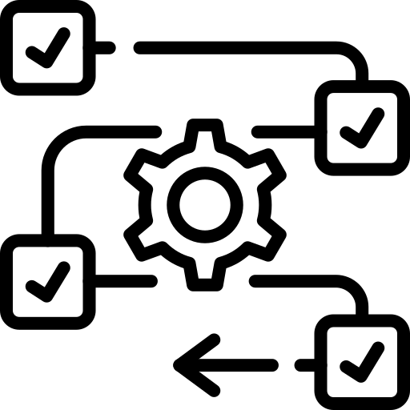
Federal Approval Process
Changing accreditors is a multi-step process.
Provide USED with accreditation & pre-accreditation materials and demonstrate reasonable cause.
Receive approval from USED to switch accreditors.
Apply for membership with a different accreditor while maintaining SACSCOC accreditation.
Receive membership from a different accreditor & notify USED.
Maintain accreditation with SACSCOC until USED has provided written notice that it acknowledges the change in accreditor.

Slide 10
Next Steps: Local Decisions
2025* | 2026* | 2027** | 2028 | 2029
Asheville-Buncombe Technical Community College Catawba Valley Community College Guilford Technical Community College Mayland Community College Stanly Community College Surry Community College Wake Technical Community College Wilson Community College | Isothermal Community College Rowan-Cabarrus Community College Wayne Community College Wilkes Community College | Caldwell Community College & Technical Institute Cape Fear Community College Craven Community College Durham Technical Community College Southwestern Community College | Central Carolina Community College Coastal Carolina Community College Mitchell Community College | Beaufort County Community College Blue Ridge Community College Brunswick Community College Edgecombe Community College Haywood Community College James Sprunt Community College Martin Community College
*Cannot achieve candidacy with new accreditor 3 years prior to reaffirmation; may stay with SACSCOC additional cycle.
**Unlikely to achieve candidacy with new accreditor 3 years prior to reaffirmation.

