Slide 1

F U T U R E R E A D Y

Slide 2

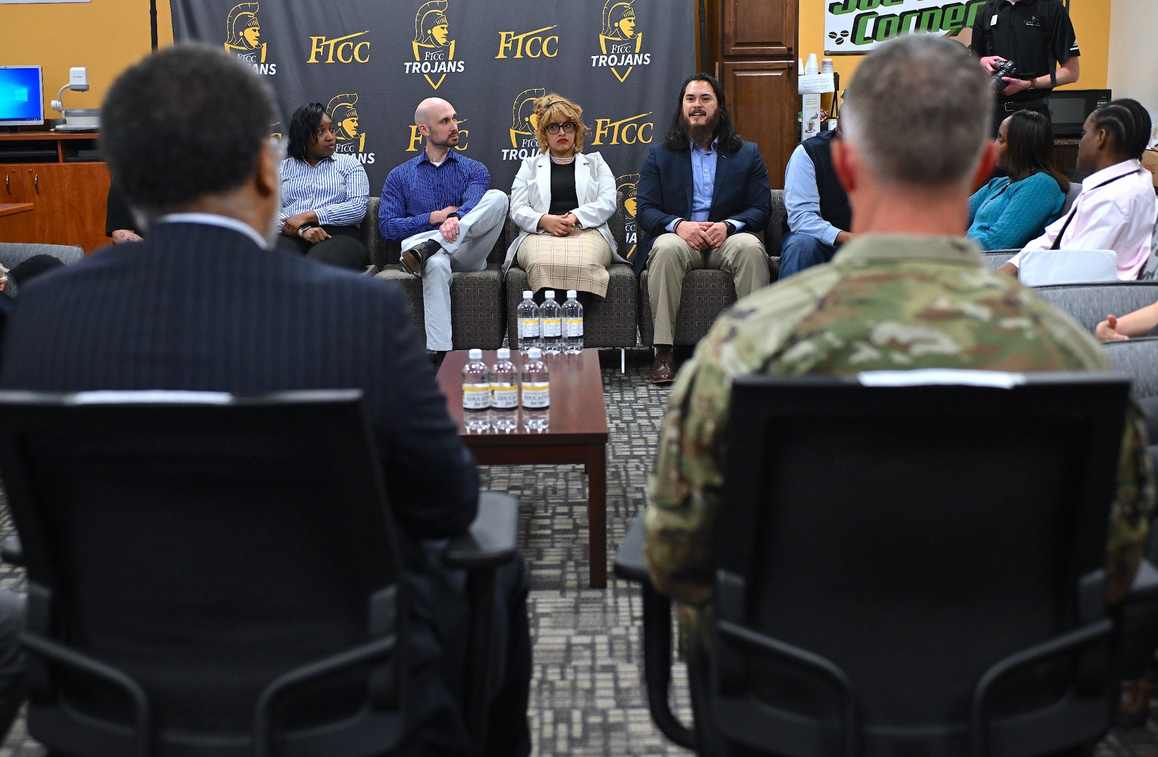
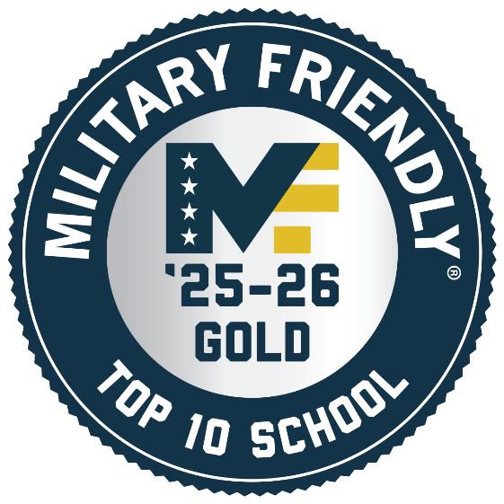

MILITARY FOCUSED
Military-connected students relate their experiences at FTCC to National Cyber Director Harry Coker, Jr., and Maj. Gen. Colin Tuley, Deputy Commanding General Fort Bragg.
Notes:
FTCC is consistently rated a Top Ten Military Friendly School in the nation in the Large Community College category by VIQTORY, which publishes GI Jobs Magazine, since the designation began. In 2025-26, FTCC ranked 5th in the nation; FTCC ranked No. 1 in 2019-20 and 2022-23. FTCC is also consistently rated a Top Military Friendly Spouse School.

Slide 3
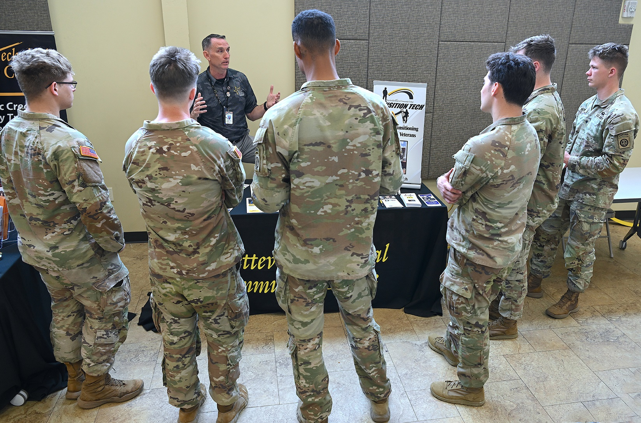
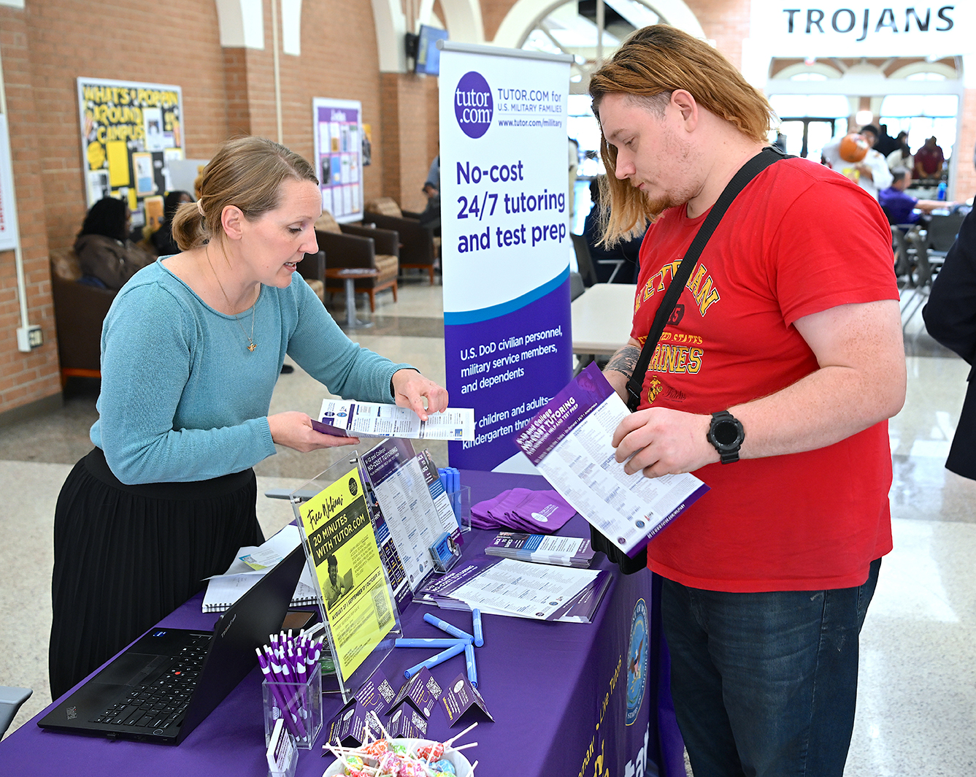
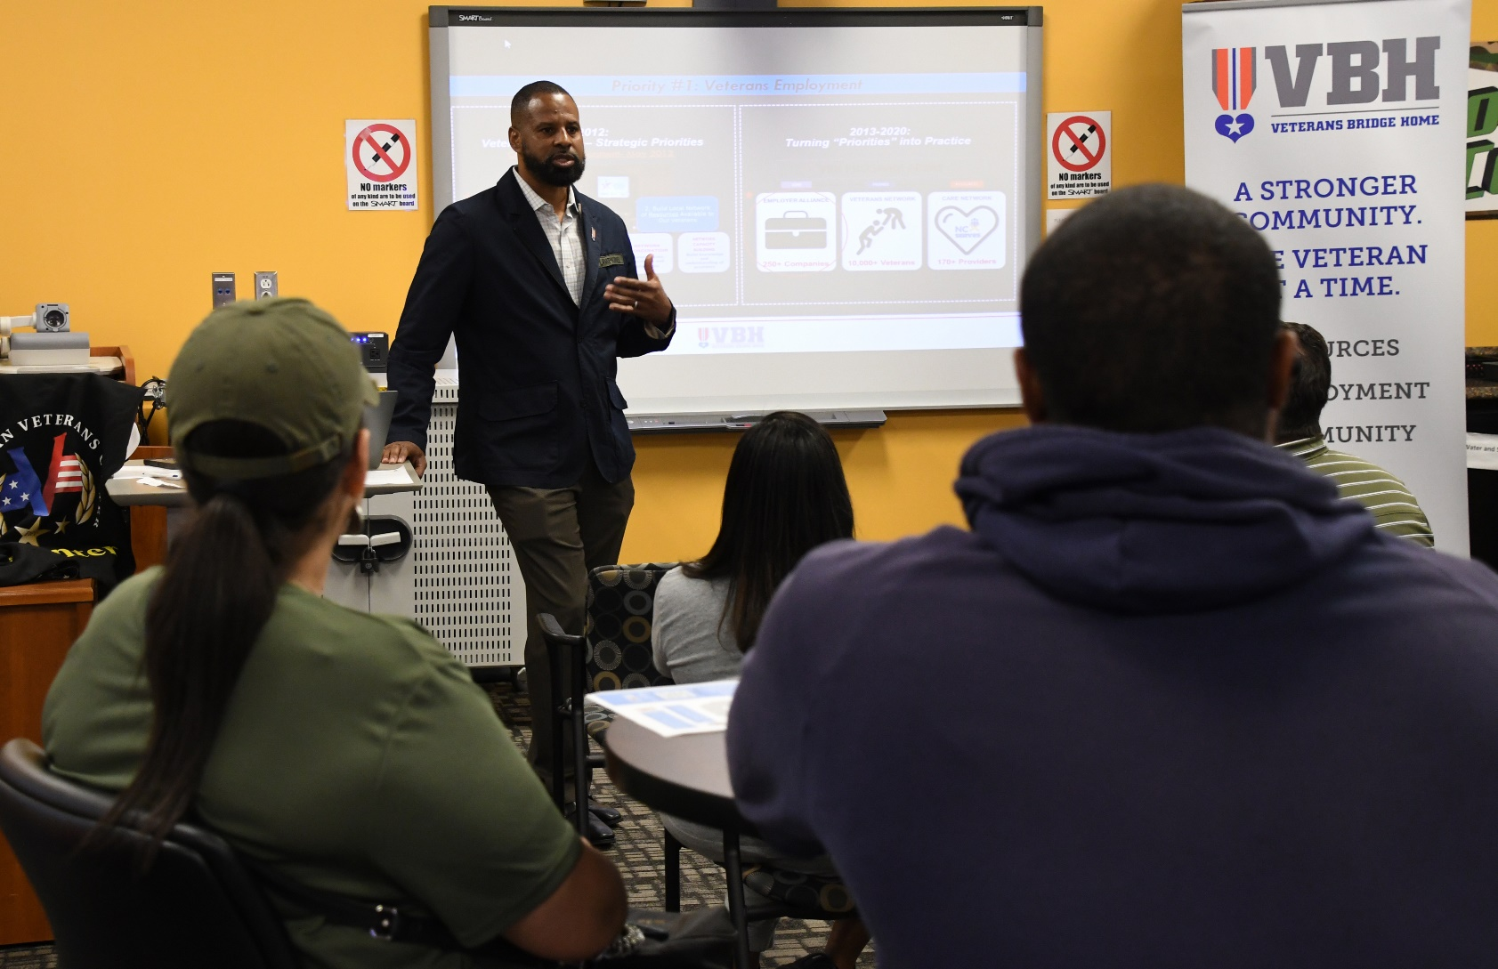
MILITARY APPRECIATION
Military/veteran resource
fair on Fayetteville campus
FTCC open house event at Fort Bragg
Warrior Wednesday session at FTCC’s All American Veterans Center
Notes:
Military appreciation events at FTCC include resource fairs, career fairs, open houses, and “Warrior Wednesday” sessions which focus on topics of particular interest to military-connected students.

Slide 4
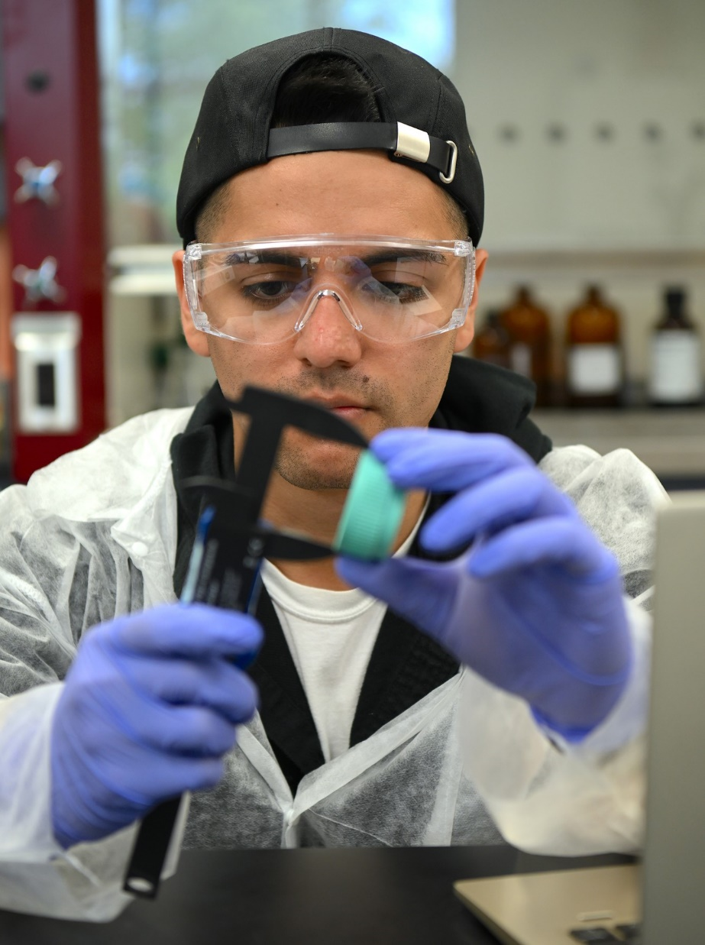
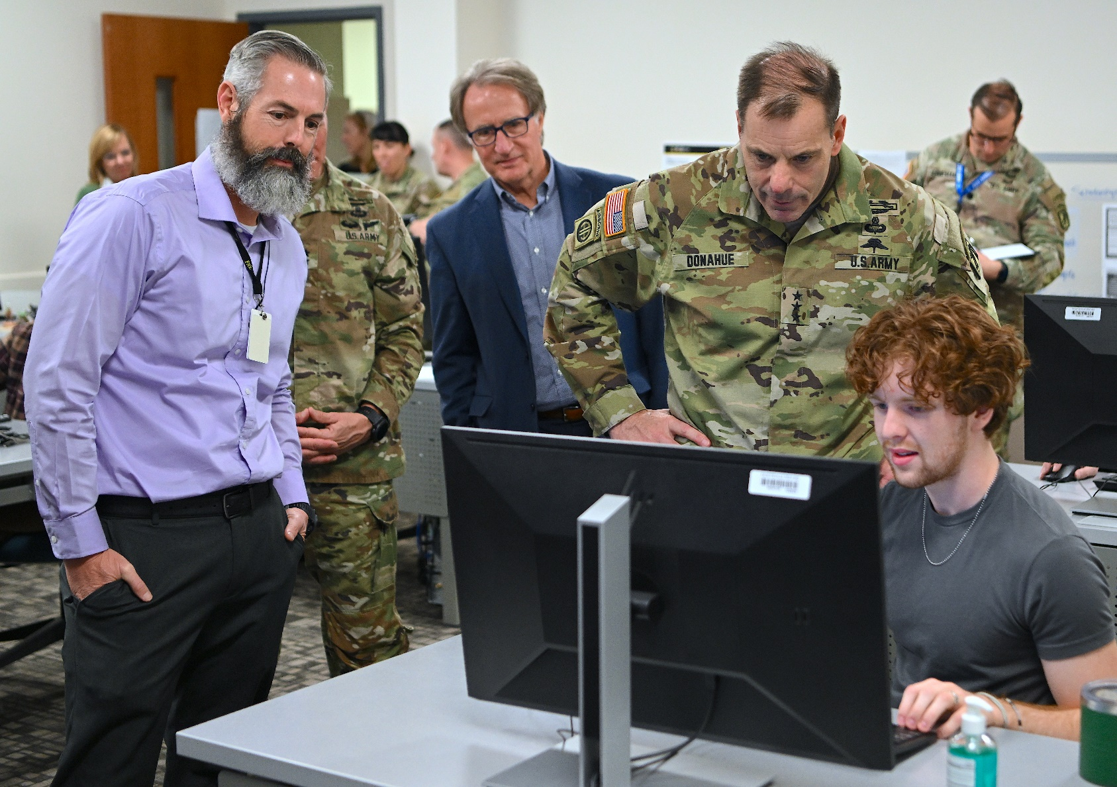
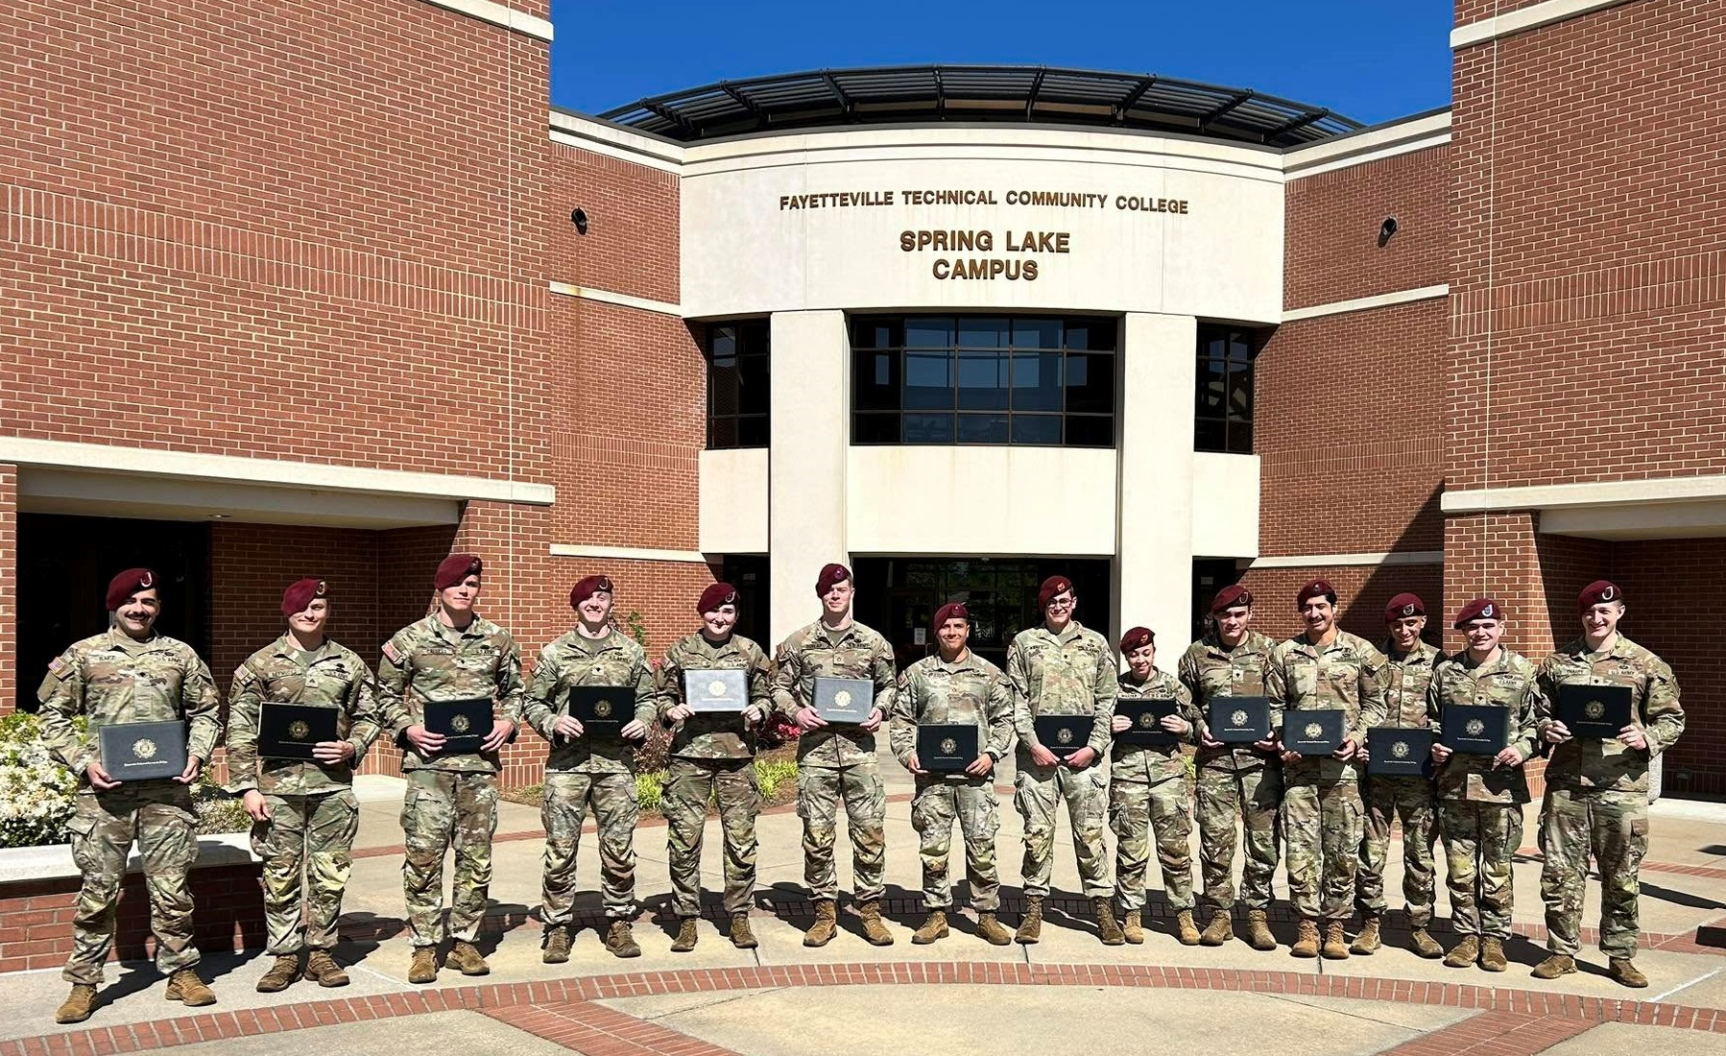
MILITARY PARTNERSHIPS
LTG Christopher Donahue visits FTCC’s Pathfinder lab.
Student in the BioWork Process Technician course
Graduates of FTCC’s Combat Paramedic course

Slide 5
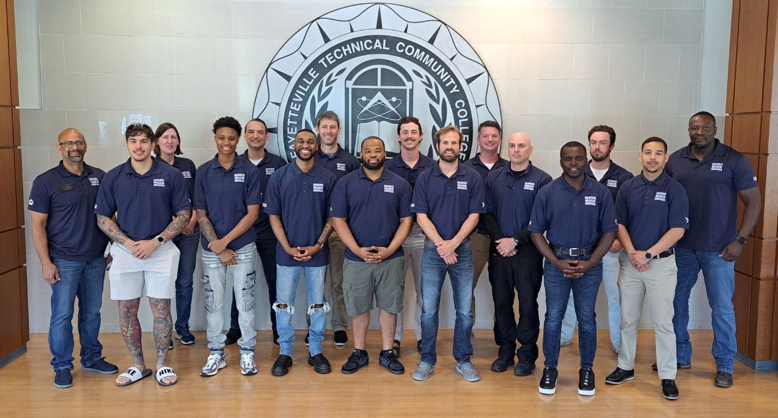
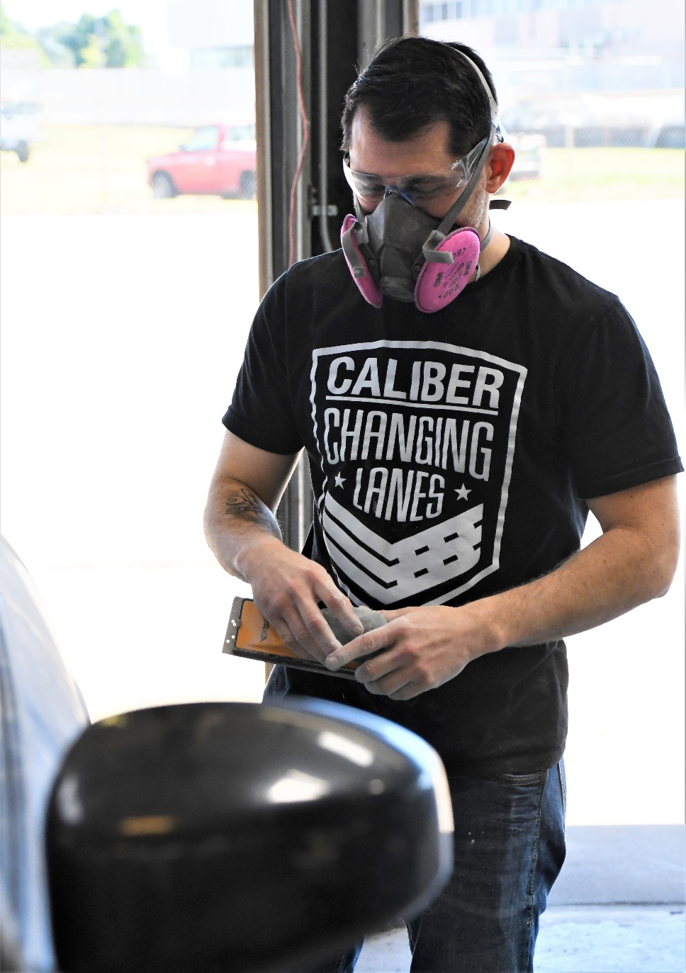
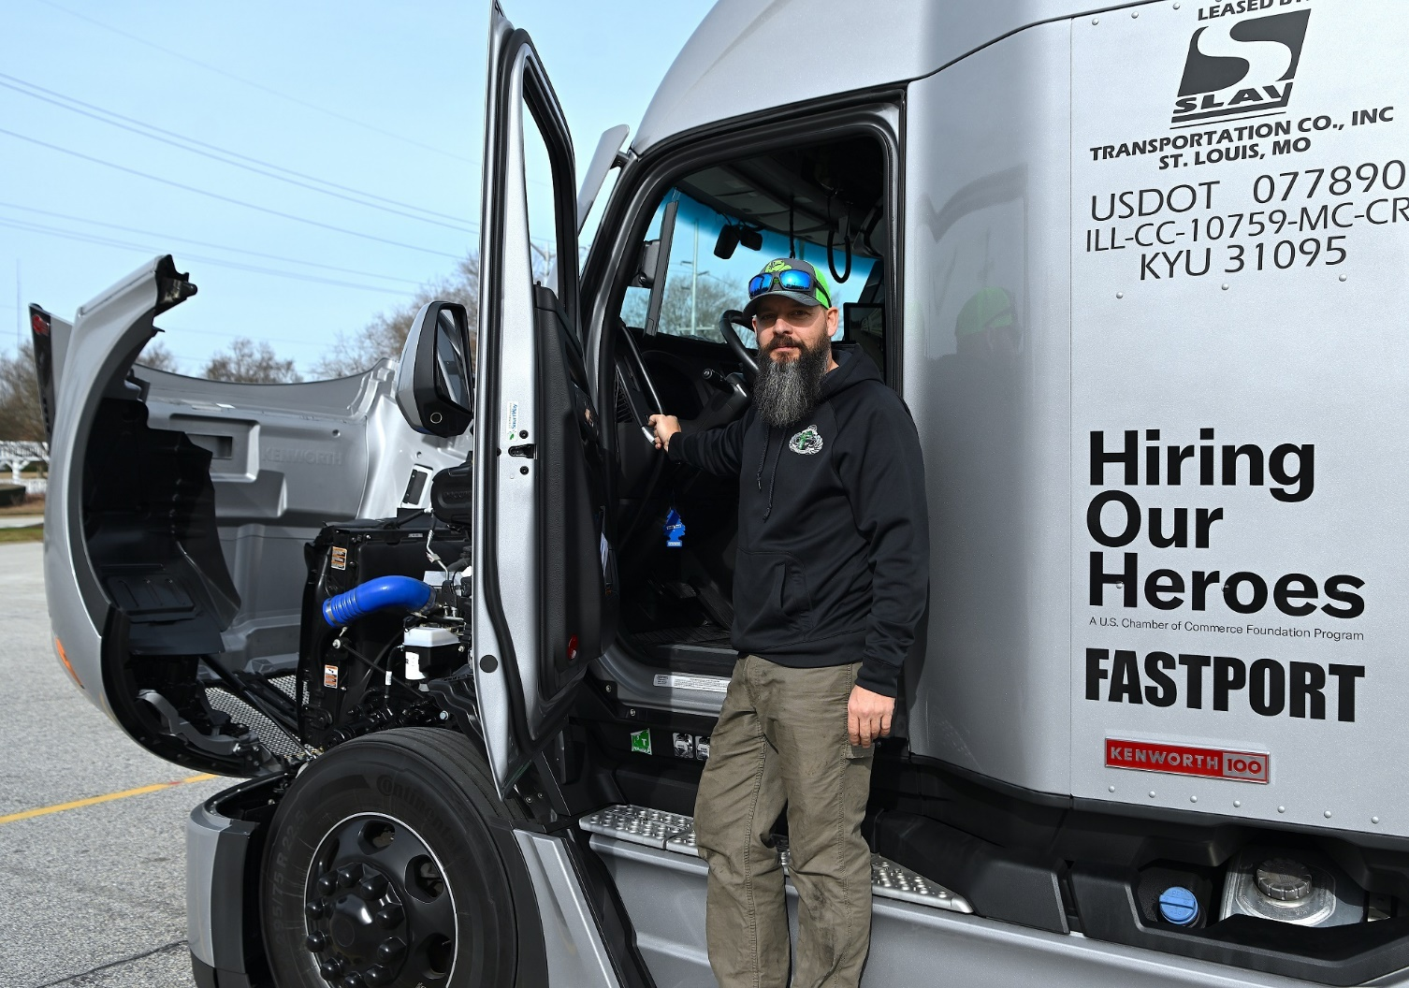
TRAINING FOR GOOD JOBS IN THE CIVILIAN WORLD
Transition Tech programs include Logistics & Distribution Management, CDL truck driving and Caliber Collision auto-body repair. These programs have a 95% hire rate.

Slide 6

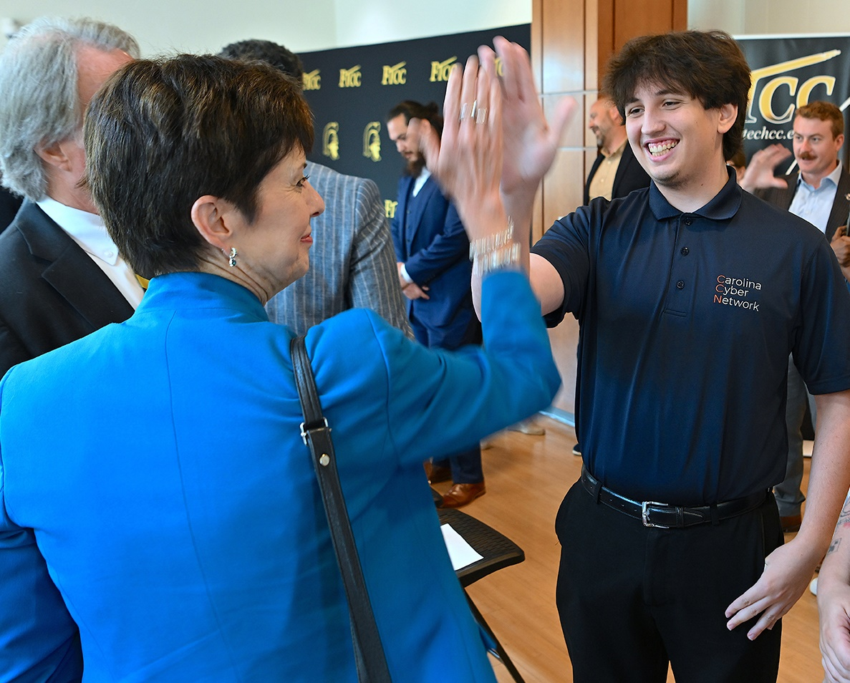
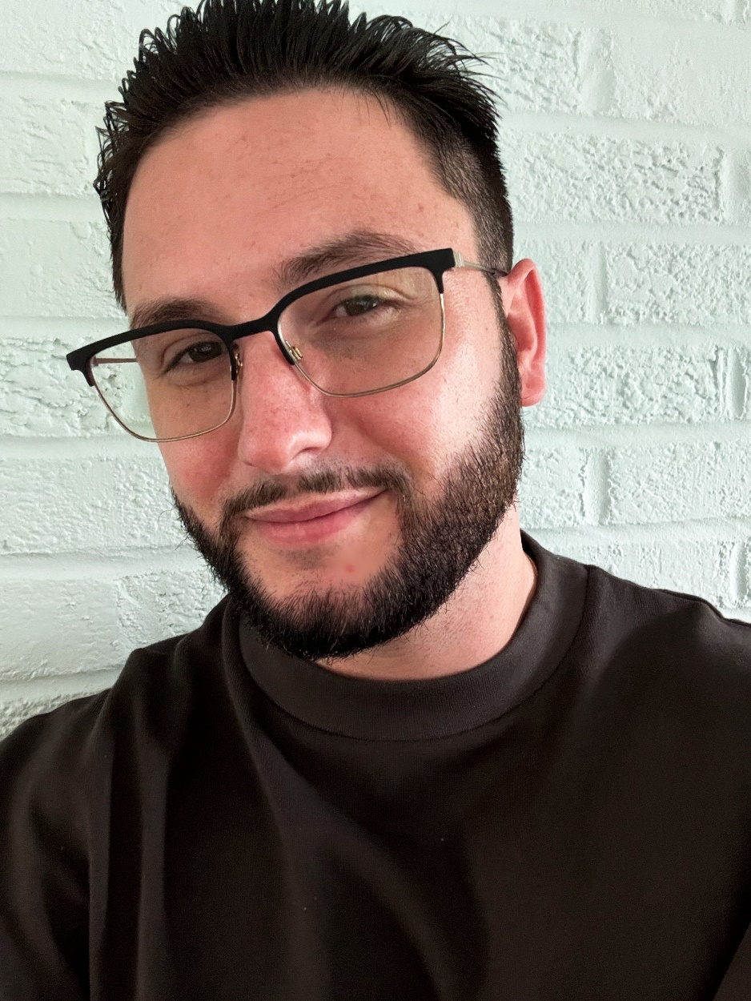
"Learn & Earn" OJT Opportunities
NC DIT Secretary Teena Piccione announced a new cybersecurity internship program in partnership with the CCN.
Air Force veteran Ryan Hodgson earned two IT degrees at FTCC and gained valuable experience through training and an internship made possible by the Carolina Cyber Network.
Now a network analyst with the NC Department of Information Technology, Hodgson said the experiences were “incredibly beneficial” and gave him a head start on preparing for the modern civilian workforce.

