Slide 1

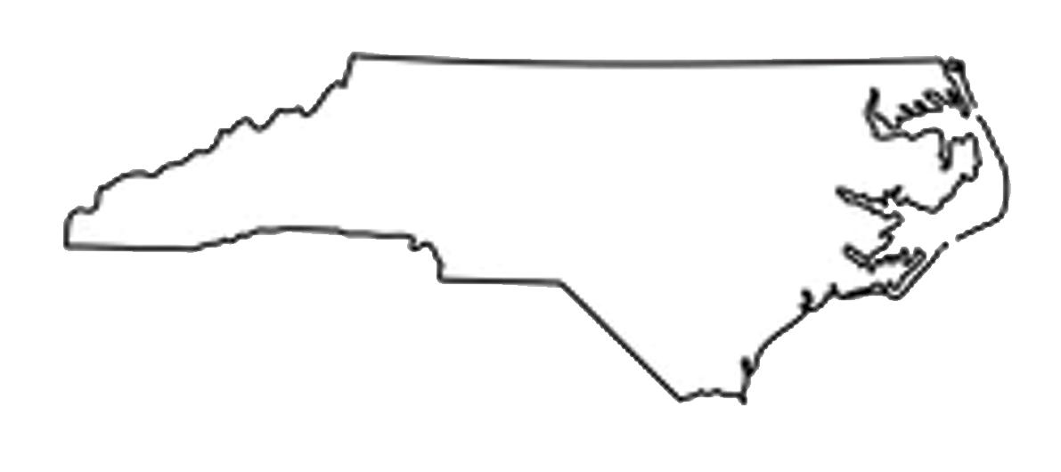
North Carolina Military Business Center: Military Impact and Defense Economy
Presented by:
Scott Dorney
Executive Director, NCMBC
scott@ncmbc.us
14 AUG 2025
ncmbc.us DEFTECH.nc.gov MatchForce.org

Slide 2

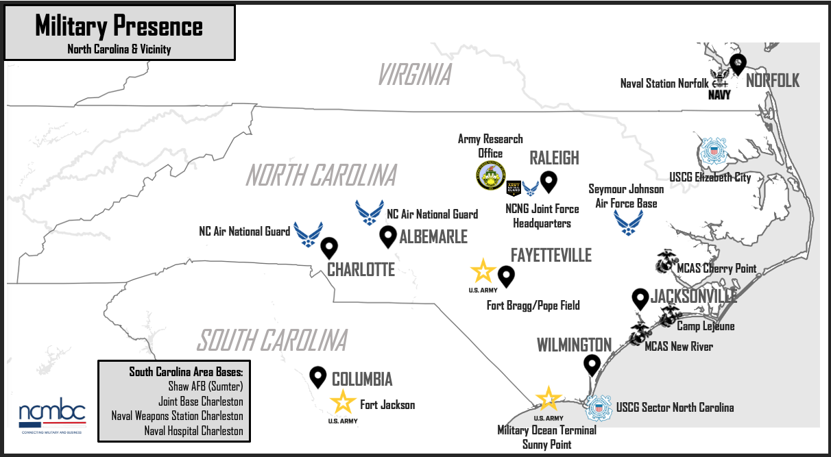
Military Presence in North Carolina
4th highest active-duty military
presence in US
6 major installations
(5 DoD, 1 DHS)
Over 100 National Guard &
Reserve facilities
Over 100,000 active, Guard
and Reserve
18,000 annual transitions

Slide 3
Military Impact on State Economy
Total Annual Impact: $79.7 billion | Gross State Product: 12.7%
Military/civilian payroll: $19.2 billion | Over 653,000 jobs; Personal income: $49 billion
Federal Contracting in NC
Federal Contracts: $8.55 billion (97 Counties) | DoD Contracts: $4.23 billion (81 Counties)
Notes:
Emphasize defense is second largest sector of NC economy (to agriculture)
Total economic impact is tremendous
One part if Contracting – our area of work

Slide 4
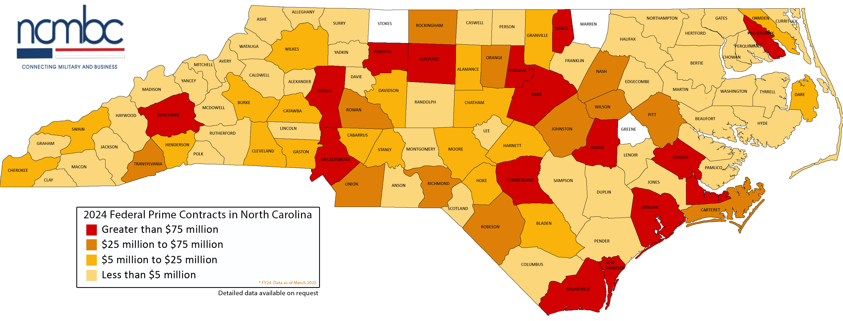
Federal Procurement in NC, FY2024

Slide 5

NCMBC: Mission, Goals and Outcomes
Enterprise | Mission
State and community college entity totally focused on the defense economy; totally State-funded | To leverage military and federal business opportunities to expand the economy, grow jobs and improve quality of life
Goals and Operations:
Increase revenues for businesses: Business Development, MatchForce, Events/Training
Support technology transition to DoD: Tech Transition team
Support integration of military into workforce
Support defense business recruitment
Outcomes
Client contract wins: 6,484 | Contract value: $18.19 billion

Slide 6
NCMBC: Serving Statewide
Business Development Team
Strategic Resources Team

Slide 7



NCMBC: 2025 - 2026 Major Events
Federal Technologies Symposium (SEP 9-10, FAY)
Medical, Biomedical, Biodefense Symposium (SEP 24-25, Chapel Hill)
Defense Industrial Sustainment Summit (NOV 18-19, Chapel Hill)
SE Region Federal Construction, Infrastructure and Environmental Summit (APR 14-16, WIL)
Federal and Defense Textile/Tactical Equipment Summit (May 19-20, RAL)

Slide 8
Discussion: NCMBC Engagement with NCCCS
Why it matters: OPPORTUNITY (for businesses, community colleges, NC)
Board: promote defense market to community colleges statewide
  Recruit businesses in college service areas
  Engage colleges in NCMBC contract opportunity distribution
  Engage NCMBC with colleges in business expansion/relocation, workforce
NCMBC: engage community colleges in expanding defense industrial base
  Synch NCMBC industrial base work with colleges’ workforce development
  Sustain collaborative work with SBC Network – mutual referrals
  Engage community college innovation assets in DoD ecosystem

Slide 9
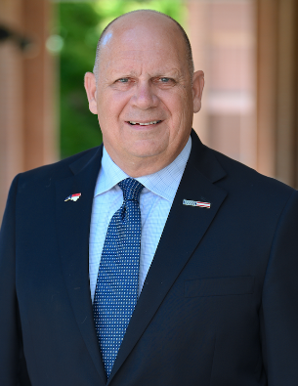

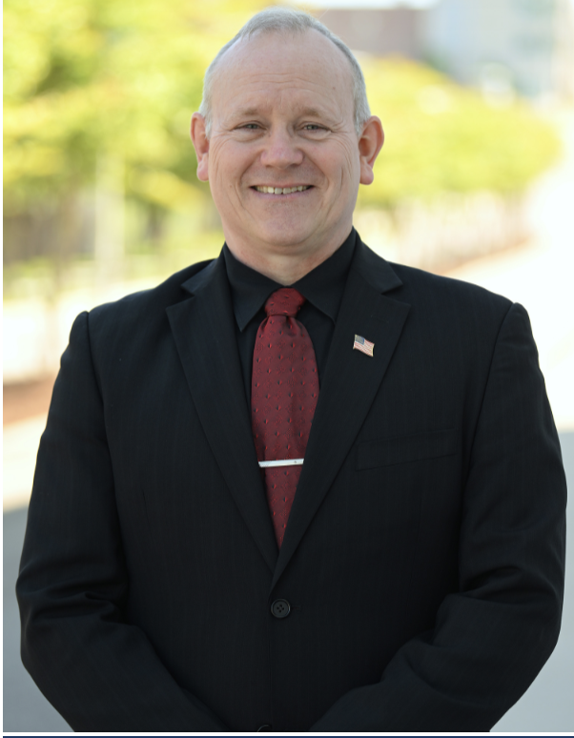
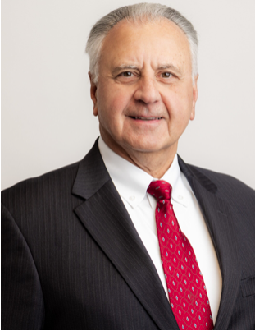
Contact Information
Scott Dorney, Executive Director, 910-678-0190, scott@ncmbc.us
Courtney Smedick, Director of Operations, 910-678-0193, courtney@ncmbc.us
Bob Burton, Defense Technologies, 910-824-9609, burtonr@ncmbc.us
Denny Lewis, Strategic Initiatives, 703-217-3127, lewisd@ncmbc.us

Slide 10
Backup Slides

Slide 11
Agenda
Introduction
Military Presence and Impact
NCMBC: Growing the Defense Economy
Lunch / Discussion

Slide 12



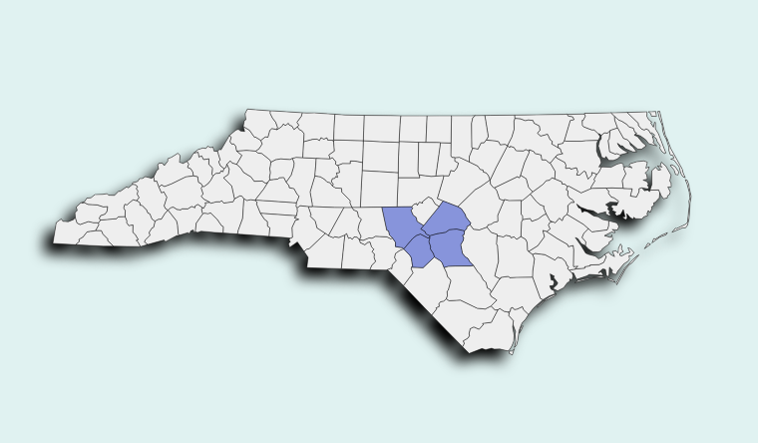




Fort Bragg
Pope Army Airfield
Federal Procurement
Cumberland: $2,372,173,657
Moore: $24,102,845
Hoke: $21,163,904
Harnett: $14,732,986
Fort Bragg/Pope Army Airfield
County(ies) located: Cumberland, Harnett, Moore, Hoke
Major commands: XVIII Airborne Corps, US Army Forces Command, US Army Reserve Command, US Army Special Operations Command, US Joint Special Operations Command, 82nd Airborne Division
Supporting Community Colleges: FTCC, Central Carolina, Sandhills
Installation Commander: LTG Gregory K. Anderson
Population
Active-duty: 43,414
Reserve Components: 1,648
DOD Civilians: 10,999
Contractors: 5,418
Family members: 62,962
https://installations.militaryonesource.mil/ https://home.army.mil/bragg/

Slide 13
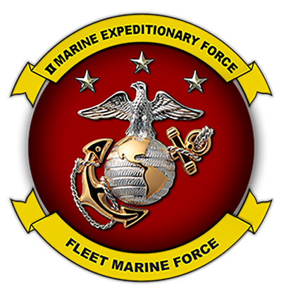

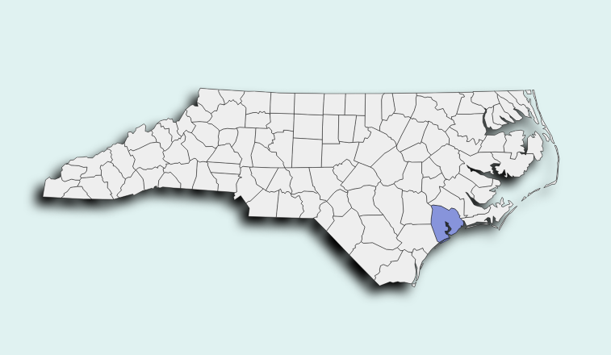
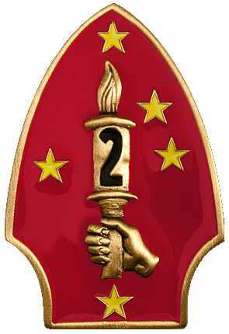
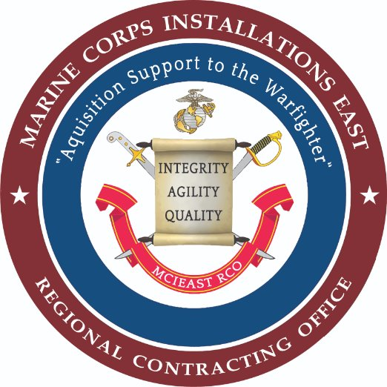

Marine Corps Base
Camp Lejeune
Federal Procurement
Onslow: $861,224,558
Marine Corps Base Camp Lejeune
County(ies) located: Onslow
Major commands: II Marine Expeditionary Force, 2d Marine Division, Marine Corps Installations East
Supporting Community Colleges: Coastal Carolina CC
Installation Commander: Brigadier General Ralph J. Rizzo
Population
Active Duty: 38,778
DoD Civilian: 3,349
Family Members: 38,769
https://installations.militaryonesource.mil/
https://www.lejeune.marines.mil/

Slide 14


Marine Corps Air Station New River
Federal Procurement
Onslow: $861,224,558
Marine Corps Air Station New River
County(ies) located: Onslow
Major commands: 2nd Marine Aircraft Wing
Supporting Community Colleges: Coastal Carolina CC
Installation Commander: Colonel Garth W. Burnett
Population
Active Duty: 6,301
DoD Civilians: 3,349
Family Members: 2,491
https://installations.militaryonesource.mil/​
https://www.newriver.marines.mil/

Slide 15

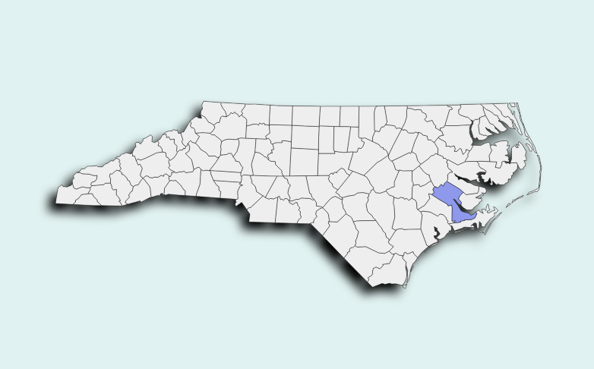
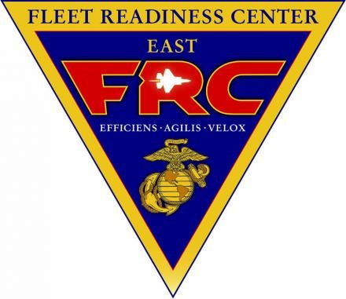
Marine Corps Air Station Cherry Point
Federal Procurement
Craven: $529,353,887
Carteret: $32,054,982
Marine Corps Air Station Cherry Point
County(ies) located: Craven
Major commands: 2nd Marine Aircraft Wing, Fleet Readiness Center East (US Navy)
Supporting Community Colleges: Craven Community College
Installation Commander: Colonel Brendan Burks
Population
Active Duty: 5,973
Reserve Components: 1,746
DoD Civilians: 5,422
Contractors: 3,700
Family Members: 6,547
https://installations.militaryonesource.mil/ https://www.cherrypoint.marines.mil/About/

Slide 16

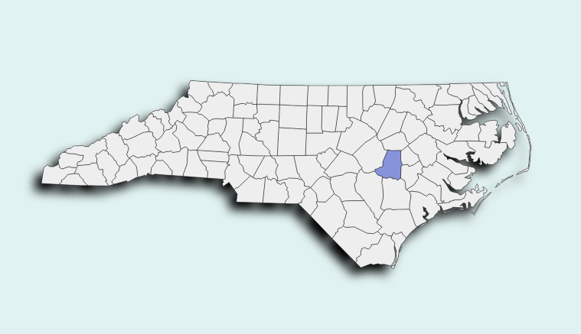
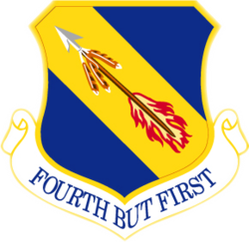

Seymour Johnson
Air Force Base
Federal Procurement
Wayne: $83,632,377.26
Seymour Johnson Air Force Base
County(ies) located: Wayne
Major commands: 4th Fighter Wing, 916th Air Refueling Wing
Supporting Community Colleges: Wayne Community College
Installation Commander: Colonel Morgan P. Lohse
Population
Active Duty: 5,259
Family Members: 5,025
Civilian: 611
Reservists: 1,166
https://installations.militaryonesource.mil/ https://www.seymourjohnson.af.mil/About-Us/

Slide 17
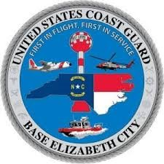
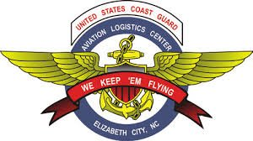
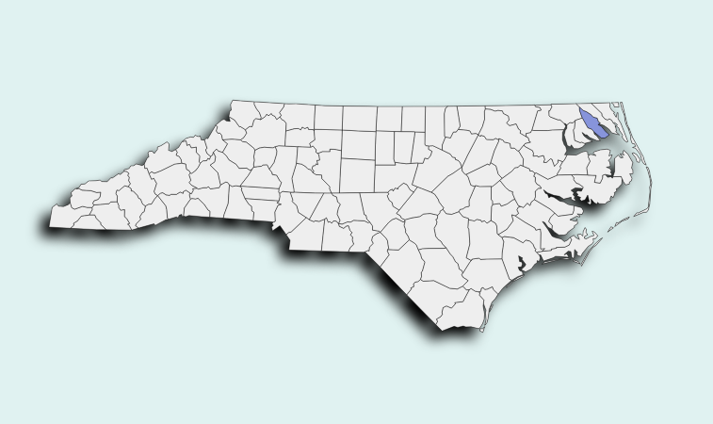



US Coast Guard Base Elizabeth City
Federal Procurement
Pasquotank: $180,390,547.57
US Coast Guard Base Elizabeth City
County(ies) located: Pasquotank
Major commands: Aviation Logistics Center, Air Station Elizabeth City, Rescue Swimmer Training Program
Supporting Community College: College of the Albemarle
Installation Commander: Commander Heidi L. Koski
Population
Active Duty: 700
Reserve Components: 200
Civilian/Contract Employees: 1600
https://installations.militaryonesource.mil/

Slide 18
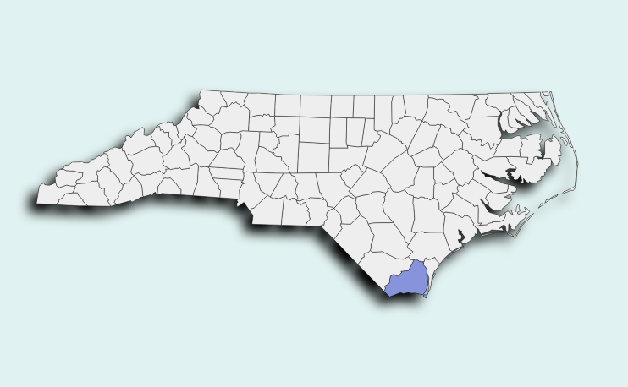

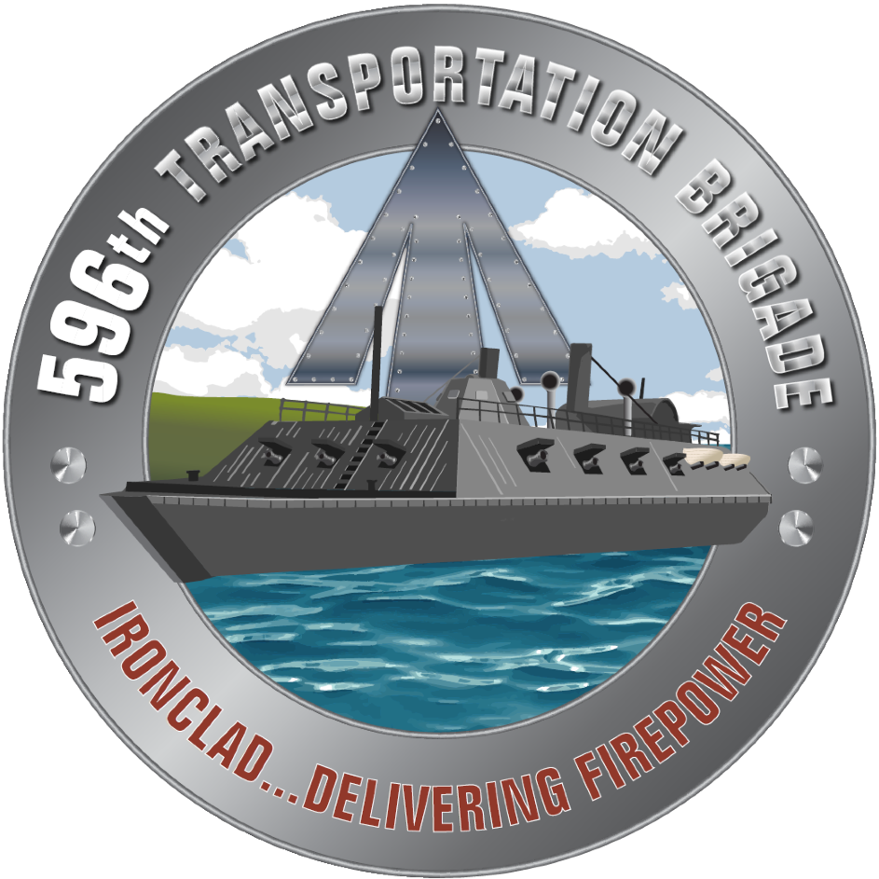
Military Ocean Terminal Sunny Point
Federal Procurement
Brunswick: $131,543,443
Military Ocean Terminal Sunny Point (MOTSU)
County(ies) located: Brunswick
Major commands: 596 Transportation Brigade
Supporting Community Colleges: Brunswick Community College
Installation Commander: Colonel Russell Henry
Population
Active duty/Civilians: 250

Slide 19





North Carolina National Guard
Federal Procurement
Wake: $362,102,624
Mecklenburg: $301,688,798
Stanly: $7,106,411
North Carolina National Guard
Counties located: Numerous; Wake (JFHQ); Mecklenburg, Stanly (Air)
Major Commands: JFHQ; 30th Armored BCT; 145th Airlift Wing
Supporting Community Colleges: All; Wake Tech, CPCC, Stanley
Installation Commander: AG, Major General Todd Hunt;
Population
Army National Guard: 8,882
Air National Guard: 1,474

Slide 20
Agenda
Introduction
Military Presence and Impact
NCMBC: Growing the Defense Economy
Lunch / Discussion

Slide 21
Situation: NC Assets for Defense
State goal: sustain installations/warfighters, grow defense economy
Business infrastructure: best in US, Community Colleges, NCMBC
Business capacity: manufacturing, services, infrastructure, research
Workforce capacity: diverse, growing, adaptable – civilian/military
Innovation ecosystem: diverse, applicable to defense, nurtured

Slide 22
NCMBC: Who We Are
The NCMBC is a statewide, business development and technology transition entity of the State of North Carolina, embedded in the state’s community colleges and headquartered at Fayetteville Technical Community College
Totally State-funded, the NCMBC is the only statewide, military-focused economic development entity in the US, and the only NC entity solely focused on growing the defense economy through existing industry

Slide 24
NC Infrastructure for Defense Economy
Networking
Strategic, Recruitment:
EDPNC/NCDoC
Operational, Business Development: NCMBC
Advocacy
Teaming
Tactical, Develop Businesses:
SBA, SBCs, SBTDC, GCAP
NCVetBiz, Defense Alliance, Chambers, etc.

Slide 25
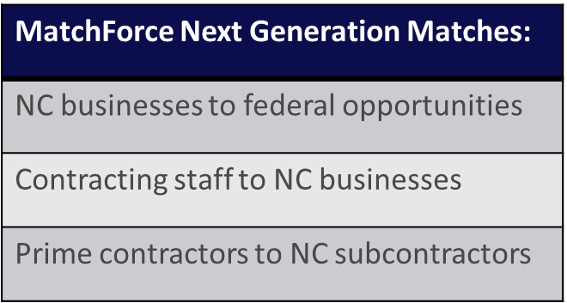
Operations: MatchForce.org
CY2005-CY2025 | Opportunities distributed: over 2.5 million | Business-Opportunity Connections: >400 million
MatchForce-Involved Wins: over 3,118 | Min Value, MatchForce Wins: over $8.24 billion

Slide 26
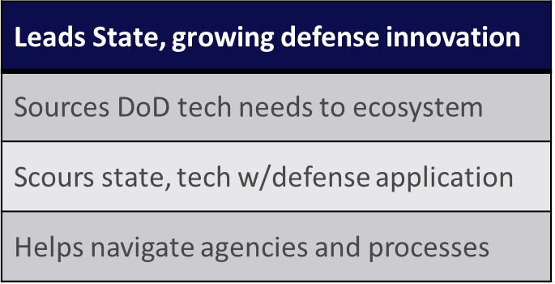

Operations: Technology Transition
CY2016-CY2024 | Opportunities distributed: over 1,400 | Innovation events: 100+
Innovation Awards: over $38 million, min value

Slide 27


Slide 28
North Carolina Data
North Carolina Number of Military and DoD Appropriated Fund Civilian Personnel
Active Duty | National Guard/Reserve | APF DoD Civilian | Total
Army: 41,959 Navy: 4,257 Marine Corps: 40,797 Air Force: 6,254 Space Force: 2 Coast Guard: 1,536 Total: 94,805 | Army National Guard: 8,882 Army: 6,102 Navy: 1,256 Marine Corps: 1,056 Air Force: 1,527 Air National Guard: 1,474 Coast Guard: 232 Total: 20,529 | Army: 8,113 Navy: 4,450 Marine Corps: 2,924 Air Force: 1,372 4th Estate: 6,299 Total: 23,158 | Grand Total: 138,493
Army: 3rd largest Navy: 13th Marine Corps: 2nd Air Force: 14th Coast Guard: 9th 4th largest overall – behind California, Virginia, and Texas | Army National Guard: 15th Army: 7th Navy: 11th Marine Corps: 7th Air Force: 17th Air National Guard: 31st Coast Guard: 9th 10th largest overall | Army: 7th Navy: 11th Marine Corps: 3rd Air Force: 26th 4th Estate: 8th 12th largest overall | 5th largest overall behind California (273,806), Virginia (247,417), Texas (217,969), and Florida (140,608)
Data pulled from DMDC on 5/28/2025
Number of Military and DoD Appropriated Fund Civilian Personnel
As of March 31, 2025.

Slide 29
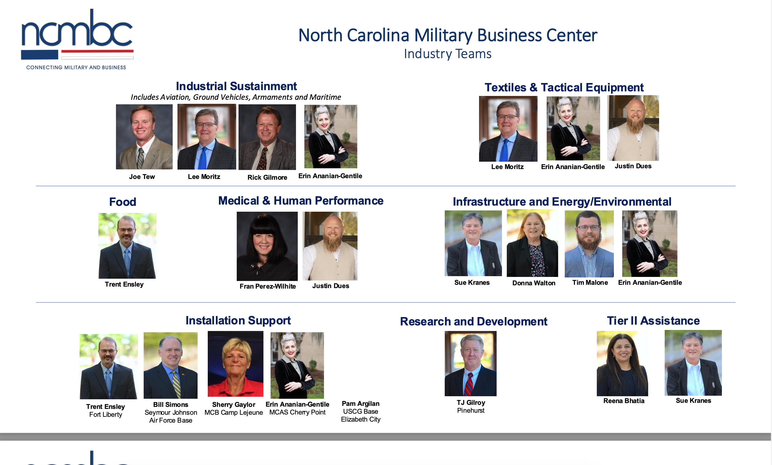

Slide 30
