Slide 1

September 2026
Quarterly Meeting

Slide 2
Purpose of Perkins V
Develop more fully the academic knowledge and technical and employability skills of secondary education students and postsecondary education students who elect to enroll in CTE curriculum programs and programs of study

Slide 3
Purpose of Perkins V
Develop more fully the academic knowledge and technical and employability skills of secondary education students and postsecondary education students who elect to enroll in CTE curriculum programs and programs of study
Notes:
The Strengthening Career and Technical Education for the 21st Century Act reauthorized and updated the Carl D. Perkins Career and Technical Education Act of 2006 to become the current Carl D. Perkins Career and Technical Education Act of 2006 as amended by the Strengthening Career and Technical Education for the 21st Century Act (Perkins V)
This updated act stresses:
- Academic, Technical, and Employability Skills
- Funding Secondary and Postsecondary CTE
- Focusing on Students who elect to enroll in CTE Programs of Study

Slide 4
Federal Programs Section: Perkins Unit
Dr. Robert Van Dyke
Associate Vice President for Federal Programs
Darice McDougald
Federal Programs Business Services Specialist
Perkins Administration
Dr. Tony Reggi
Associate State Director for Perkins Grant Administration
Patti Coultas
Assistant Director for Perkins Regional Services-East
Stefanie Schroeder
Assistant Director for Perkins Regional Services-West
Monitoring and Accountability
Dr. Michael Tilley
Associate State Director for Monitoring and Accountability
Brandy Brown
Monitoring and Reporting Specialist
Professional Development
Daniel Loges
Director of Professional Development
Leigh Davidson
Professional Development and Distance Learning Specialist
Performance and Accountability
Jessica Rieger
Director of Performance and Accountability
Courtney Jackson
Performance and Accountability Specialist

Slide 5
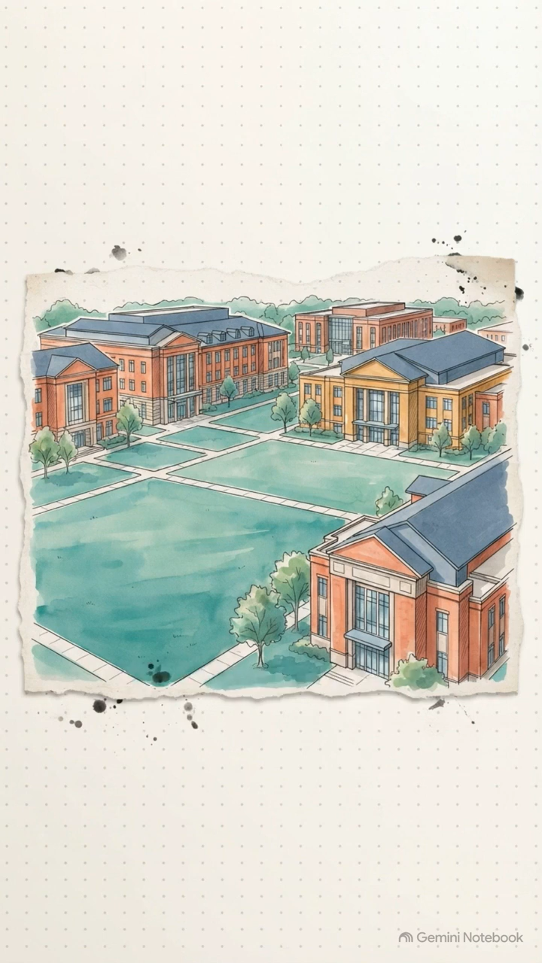
2025-2026 End of Year Key Findings

Slide 6
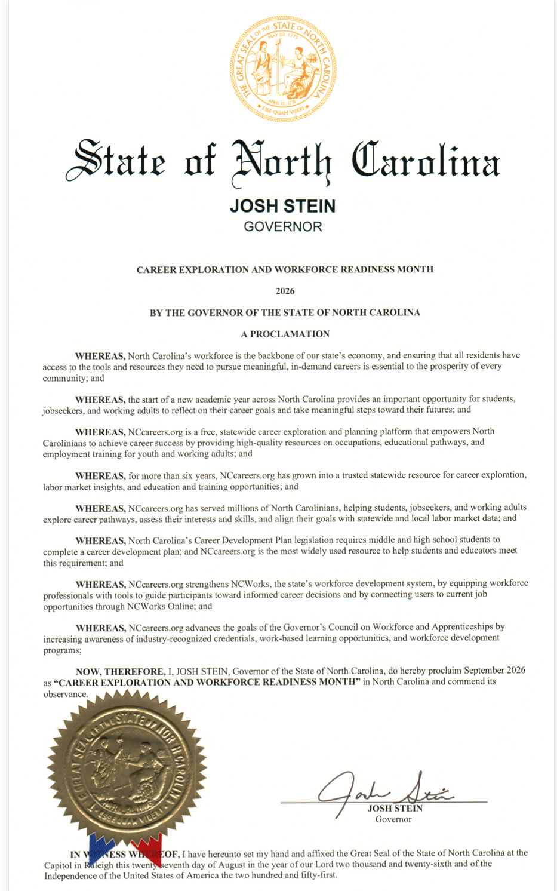
Career Exploration and Workforce Readiness Month

Slide 7
Monitoring and Compliance: Update on Process
2026-2027 Comprehensive Monitoring Cycle Underway
17 Colleges Selected and Notified
Federal Programs Monitoring Guide
Overview of Process
  Annual Risk Assessment – Completed
  Colleges Selected and Notified – Completed
  Monitoring Overview Webinar – Completed
  Individual Pre-Monitoring Meeting – In Progress
  Documentation Submission – In Progress
  Onsite or Virtual Visit – October through January
  Post-Monitoring Meeting – December through January
  Official Monitoring Report – December through March
  Corrective Action Plan (as needed) – January through April
All colleges will receive at least one Perkins comprehensive monitoring visit from 2025-2029

Slide 8
Monitoring and Compliance: Time and Effort
2026-2027 Continuous Monitoring Underway
Time and Effort Training Webinar – August 20, 2026
All Perkins V funded employees must submit Semi-Annual or Monthly Time and Effort Certifications
If a position is 100% funded by Perkins V, a semi-annual submission is needed (due January 15, 2027 and July 15, 2027)
If a position is funded in part by Perkins V, a monthly submission is needed (due 15th of each month, beginning October 15, 2026)
Do not sign prior to end of reporting period
Time and Effort Forms
Submit in the 2026-2027 Perkins Basic Grant Data System – Moodle Course
Q&A Document Forthcoming

Slide 9
Methods of Administration (MOA)
USDOE rescinded the MOA Guidelines (Appendix B to Title 34 of the Code of Federal Regulations Part 100)
NCCCS sunset the MOA program starting July 1, 2026
Will not monitor colleges with open Voluntary Compliance Plans
Colleges must comply with applicable federal requirements:
  Title VI of the Civil Rights Act of 1964
  Title IX of the Education Amendments of 1972
  Section 504 of the Rehabilitation Act of 1973
  The Americans with Disabilities Act (ADA)
  Other applicable federal and state civil rights laws

Slide 10
2026-27 Upcoming Grant Items
October 14–16, 2026
  Attend the Fall Perkins Meeting as Presession in Raleigh (October 14).
  Attend the NCCCS System Conference in Raleigh (October 14–16).
October 31, 206
  Submit Carryforward Budget Modification
November 20, 2026
  Submit Negotiated Levels of Performance Acknowledgement for 2026–2027.

Slide 11
Carryforward Update
2025-26 Basic Grant had $569,343.00 to carry forward
Dr. Sullivan, Acting System President and CEO, will review and approve memo with carryforward allocations
Stefanie and Patti have draft allocations for Budget Modifications

Slide 12
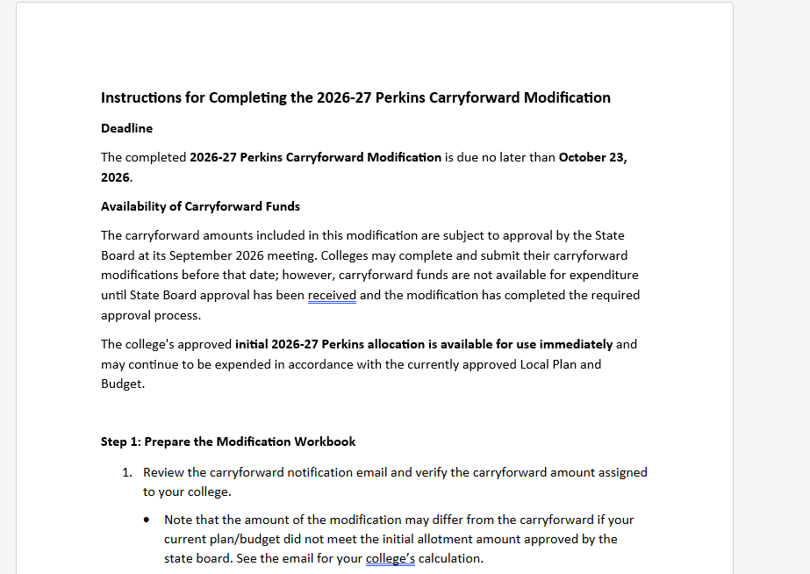
Budget Modification Instructions
Instructions emailed with carryforward allocation

Slide 13

Perkins Recruitment Leadership Project
We are looking for colleges to participate!
A team of 3-4 from your college will work with The Rucks Group to create and implement a recruitment plan for 1-3 non-traditional CTE Programs.
October 14 Fall Meeting
November 17-18 Caraway Conference Center
January – April: 2 virtual consultations
May 18-19 Caraway Conference Center
See email sent earlier today to Perkins Program Coordinators
Contact Patti for more information.

Slide 14
In-person Perkins meetings
Event Title | Event Details
Fall Perkins Meeting | October 14, 2026 9:00 a.m. - 5:00 p.m. Raleigh Convention Center
Spring Perkins Meeting | April 21, 2027 9:00 a.m. - 5:00 p.m. Koury Convention Center, Greensboro
Notes:
Register now and let the system remind you.

Slide 15
Perkins Quarterly Update Webinars
Attendance (or viewing the recording within 30 days) is recorded on the
monitoring rubric.
Perkins Technical Assistance – NCCCS Has the link to the Perkins YouTube Channel
Date | Meeting Registration Link
September 8, 2026 | The recording will be on the Perkins YouTube Channel
November 10, 2026 | Zoom Registration Link
March 9, 2027 | Zoom Registration Link
May 11, 2027 | Zoom Registration Link
Notes:
Register now and let the system remind you.

Slide 16
Upcoming Perkins Events
Perkins Fall Meeting
October 14, 2026, Raleigh Convention Center (9AM-3PM)
NCCCS System Conference
October 14–16, 2026, Raleigh Convention Center
NC ACTE Postsecondary CTE Summit
April 21, 2027, Koury Convention Center
SkillsUSA NC State Leadership & Skills Conference
April 21–23, 2027, Koury Convention Center
April 22, Postsecondary Competitions
ACTE’s Postsecondary CTE Summit
September 16–18, 2026, Arlington, Virginia
Postsecondary CTE Event - ACTE Online
Perkins Spring Meeting
February 25-26, 2027, Carteret Community College

Slide 17
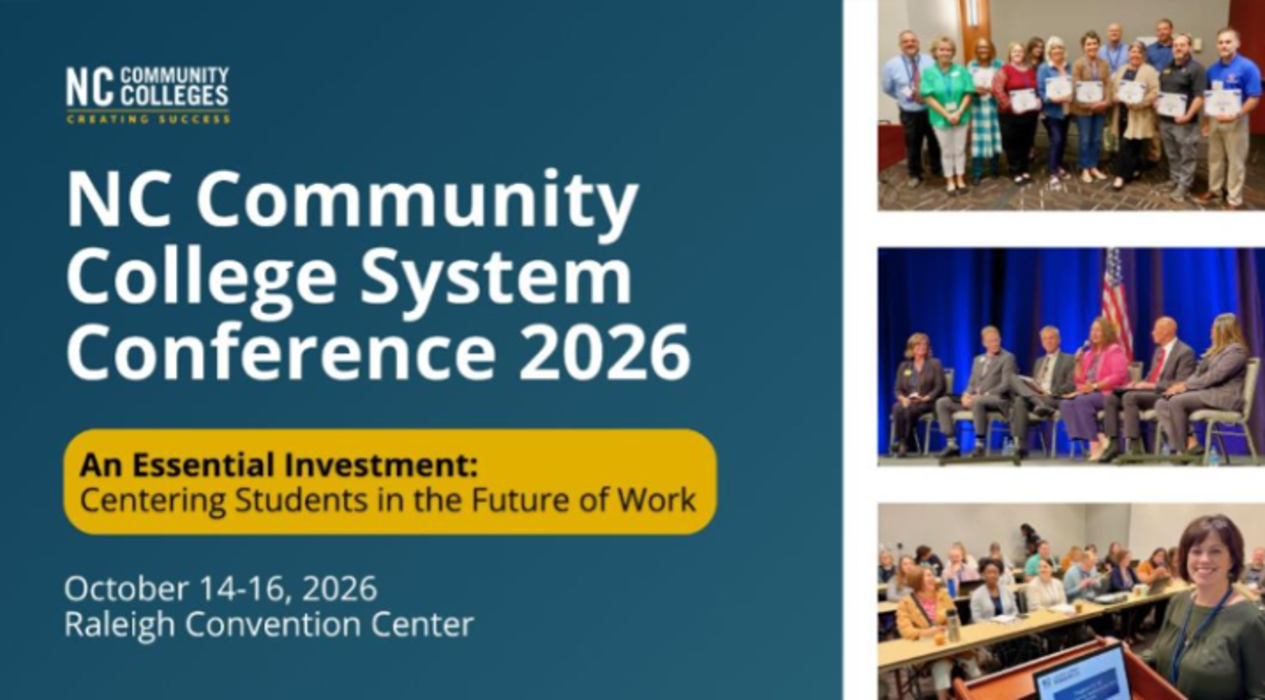
2026 NCCCS System Conference

Slide 18

NC ACTE PACE CTE Summit Save the Date
25-26,

Slide 19
NC ACTE Postsecondary CTE Summit Call for Proposals
February 25–26, 2027 | Carteret Community College | Morehead City, NC
Theme: Anchored in Excellence, Charting the Future of CTE
We are now accepting proposals for the 2027 North Carolina ACTE Postsecondary CTE Summit, hosted at Carteret Community College in beautiful Morehead City, NC. This annual event brings together community and technical college educators, administrators, and workforce partners from across the state to share innovative practices, strengthen partnerships, and advance student success in postsecondary career and technical education.
This year's theme, Anchored in Excellence, Charting the Future of CTE, reflects the strong foundation of postsecondary Career and Technical Education across North Carolina and our shared vision for the future. As postsecondary CTE leaders, we are anchored by our commitment to excellence in teaching, learning, and workforce development. Together, we are charting the future of CTE through innovation, collaboration, and an unwavering dedication to student success. We invite you to submit engaging and impactful session proposals that showcase innovative practices, meaningful partnerships, and strategies that strengthen student success while shaping the future of Career and Technical Education.
Whether you're leading transformative programs, leveraging data to improve outcomes, strengthening industry connections, or finding creative ways to support learners, we want to hear from you!
Submit your proposals here: North Carolina ACTE Postsecondary CTE Summit - Call for Proposals – Fill out form
Proposal Deadline: September 30, 2026
Notification of Acceptance: October 30, 2026
Contact Pam Gibson, Dean of Engineering & Applied Technology, Fay Tech, gibsonp@faytechcc.edu

Slide 20
Thank you

